Slide 1

Enterprise Integration Patterns
Dima Ionut Daniel

Slide 2
Contents
What is EIP?
Integration Characteristics
Messaging Systems
Messaging Concepts
Message Routing
Splitter
Aggregator
Content Enricher
Claim Check
Integration Basics
Conclussion
Bibliography

Slide 3

What is EIP?
A pattern solves a limitless variety of problems within bounded problem space.
Patterns describe commonly accepted solutions to recurring problems.
The patterns helps developers design and implement integration solutions more rapidly and reliably.

Slide 4
Integration Characteristics
All integration solutions deals with following challenges:
Change is inevitable: applications changes every time. An integration solution needs to minimize the dependencies from one system to another, using loose coupling.
Applications are different: the systems are using different programming languages, OS, data formats, etc. An integration solution needs to interface with all these different technologies.
Network problems: Networks are slow and creates delays between the systems.

Slide 5
Integration Characteristics(cont.)
The previous challenges are overcome by using the following approaches:
File Transfer: one system is writing a file and the other system is reading it.
Shared Databases: multiple application use the same DB.
Remote Procedure Invocations: applications exposes some API to be invoked in real-time and sync.
Messaging: applications publishes messages to a message channel for other applications to read them later; the applications must agree(use the same message format) on the asynchrously channel.
All the approaches have pros and cons.

Slide 6
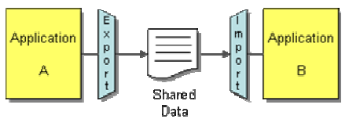
Integration Characteristics(cont.)
In file transfer each application produce files containing information that other applications need to
consume. The data format can be of different types, text, xml, etc.
The advantage of files is that integrators need no knowledge of the internals of an application.
The applications must agree on file naming conventions and the directories they appear in.
File Transfer updates tend to occur infrequently and as result the systems can get out of synchronization.

Slide 7
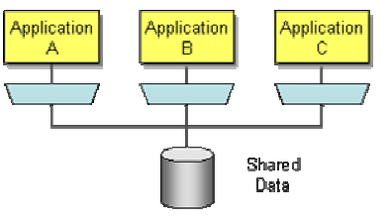
Integration Characteristics(cont.)
Shared Database is made much easier by the widespread use of SQL-based relational databases.
Multiple applications using a Shared Database to frequently read and modify the same data can cause performance bottlenecks, deadlocks as each application locks others out of the data.

Slide 8
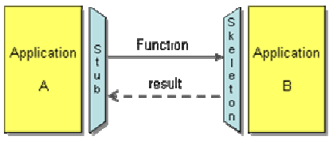
Integration Characteristics(cont.)
There are a number of Remote Procedure Call (RPC) approaches: CORBA, COM, .NET Remoting,Java RMI, etc.
Applications can provide multiple interfaces to the same data, allowing some clients to see one style and others another.
A particularly valuable feature of web services is that they work easily with HTTP, which is easy to get through firewalls.

Slide 9
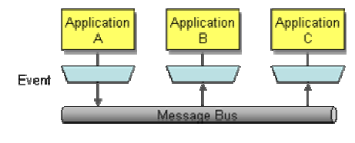
Integration Characteristics(cont.)
THe messaging approach is used to transfer packets of data frequently, immediately, reliably, and asynchronously,
using customizable formats.
Sending a message does not require both systems to be up and ready at the same time.
Messages can be transformed in transit without either the sender or receiver knowing about the transformation.
The decoupling allows integrators to broadcast messages to multiple receivers.

Slide 10
Messaging Concepts
Channels - a virtual pipe that connects a sender to a receiver
Messages - packet of data that can be transmitted on a channel
Routing - message may have to go through several channels to reach its final destination
Transformation - the message must go through an intermediate filter(Message Translator) in case the message may need transformation
Endpoints - a bridge code that enable the application to send and receive messages

Slide 11
Messaging Systems
Messaging is a technology that enables high-speed, asynchronous.
Programs communicate by sending packets of data called messages to each other.
Channels, also known as queues, connects the programs and convey messages.
A sender or producer is a program that sends a message by writing the message to a channel.
A receiver or consumer is a program that receives a message by reading (and removing) it from a channel.
A message contains two parts, a header and a body.
The header contains meta-information about the message—who sent it, where it’s going, etc.;
The body contains the data being transmitted and is ignored by the messaging system.

Slide 12
Messaging Systems (cont.)
Messaging capabilities are typically provided by messaging system or message-oriented middleware (MOM).
The messaging system coordinates and manages the sending and receiving of messages.
If the network may not be working, MOM may fail to transmit the data properly.
A messaging system overcomes these limitations by repeatedly trying to transmit the message until it succeeds.

Slide 13
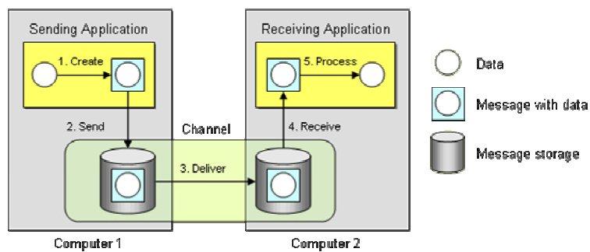
Messaging Systems (cont.)
The diagram shows 2 messaging concepts. In step 2, the sender transmits the message to the message channel.
Send and forget: In step 2, the sender transmits the message to the message channel. Once that send is complete, the sender can go on to other work while the messaging system transmits the message in the background.
Store and forward: In step 2, the sender transmits the message to the message channel. MOM stores the message on sender side and forwards the message to the receiver.

Slide 14
Messaging Systems (cont.)
Reasons to use messaging:
Remote communication: Messaging enables separate applications to communicate and transfer data.
Integration: These systems likely use different languages, technologies and platforms.
Asynchronous Communication: The "send and forget" approach is used.
Throttling: Multiple remote procedure calls on a single receiver at the same time can overload the receiver.
Disconnected Operation: some applications are designed to run disconnected from the network.
Mediation: The MOM acts as a mediator between all of the programs that can send and receive messages.
Thread Management: Asynchronous communication means that one application does not have to block while waiting for another application to perform a task.

Slide 15
Messaging Systems (cont.)
Messaging challenges:
Complex programming model: the equivalent of a simple method call can require a request message and a request channel, a reply message and a reply channel, a correlation identifier and an invalid message queue
Sequence issues: Message channels guarantee message delivery, but they do not guarantee when the message will be delivered.
Performance: Messaging systems do add some overhead to communication.
Vendor lock-in: Some MOM systems implementations rely on proprietary protocols. As a result, different MOM systems usually do not connect to one another.

Slide 16
Message Routing
Message Router - decouples a message source from the destination of the message.
Message Routing groups:
Simple Routers: routes messages from one inbound channel to one or more outbound channels
Composed Routers: combine multiple simple routers to create more complex message flows
Architectural Patterns: architectural styles based on Message Routers

Slide 17
Message Routing (cont.)
The Content-Based Router inspects the content of a message and routes it to another channel based on the content of the message.
A Message Filter is a special form of a Content-Based Router. It examines the message content and passes the message to another channel if the message content matches certain criteria.
A Recipient List is a Content-Based Router that can route a single message to more than one destination channel.
In case some messages are big a Splitter can be use. Each message can then be routed further and processed individually
To recombine the message an Aggregator can be used. An Aggregator can receive a stream of messages, identify related messages and combine them into a single message.

Slide 18
Message Routing (cont.)
During parallel processing some messages can be processed out of order. Some components depend on the correct sequence of individual messages, for example ledger-based systems.
The Resequencer puts out-of-sequence messages back into sequence. The Resequencer is a stateful Message Router because it may need to store a number of messages internally until the message arrives that completes the sequence.
Unlike the Aggregator, the Resequencer ultimately publishes the same number of messages it consumed.

Slide 19
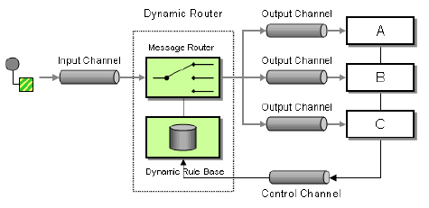
Message Routing (cont.)
Dynamic Router, besides the usual input and output channels, uses an additional control channel
During system start-up, each potential recipient sends a special message to the Dynamic Router on this control channel, announcing its presence and listing the conditions under which it can handle a message.
The Dynamic Router stores the 'preferences' for each participant in a rule base.
It also requires the Dynamic Router to store the rules in a persistent way.
The Dynamic Router could send a broadcast message to all possible participants to trigger them to reply with the control message.

Slide 20
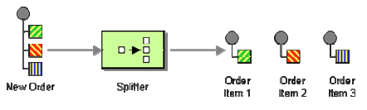
Splitter
A Splitter breaks the composite message into a series of individual messages, each containing data related to one item.
Many enterprise integration systems store message data in a tree structure.
Iterating splitters iterates through all children under a specified node and send one message for each child node.
In many instances it is helpful to split these mega-messages into individual messages. The resulting messages are often published to different channels rather than the same channel because they represent messages of different sub-types.

Slide 21
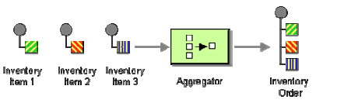
Aggregator
An Aggregator collects and store individual messages until a complete set of related messages has been received; It publishes a single message distilled from the individual messages.
The Aggregator is a special Filter that receives a stream of messages and identifies messages that are correlated.
When designing an Aggregator we need to implement the following:
Correlation: which incoming messages belong together
Completeness Condition: publish the result message when it's ready
Aggregation Algorithm: how do we combine the received messages into a single result message

Slide 22
Aggregator (cont.)
An Aggregator collects and store individual messages until a complete set of related messages has been received; It publishes a single message distilled from the individual messages.
The Aggregator is a special Filter that receives a stream of messages and identifies messages that are correlated.
When designing an Aggregator we need to implement the following:
Correlation: which incoming messages belong together
Completeness Condition: publish the result message when it's ready
Aggregation Algorithm: how do we combine the received messages into a single result message

Slide 23
Aggregator (cont.)
Aggregation Strategies
Wait for All: wait until all responses are received.
Time Out: wait for a specified length of time for responses and then make a decision by evaluating those responses received within that time limit
First Best: wait only until the first (fastest) response is received and ignore all other responses
Time Out with Override: Wait for a specified amount of time or until a message with a preset minimum score has been received
External Event: sometimes the aggregation is concluded by the arrival of an external business event

Slide 24
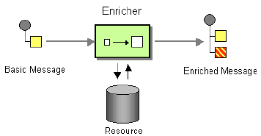
Content Enricher
A Content Enricher is a specialized transformer that access an external data source in order to augment a message with missing information.
The Content Enricher uses information inside the incoming message to retrieve data from an external source
After the Content Enricher retrieves the required data from the resource, it appends the data to the message.
Common sources for the new data are:
Computation: may be able to compute the missing information
Environment: retrieve the additional data from the operating environment
External Systems: missing data resource can take on a number of forms, including a database, a file, an LDAP directory, a system

Slide 25
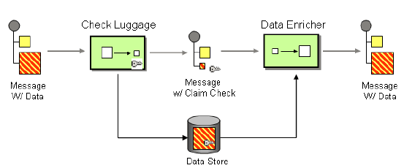
Claim Check
Moving large amounts of data via messages may be inefficient. We can store and retrieve later the correct data items associated with a message.
Claim Check pattern:
A message with data arrives.
The "Check Luggage" component generates a unique key for the information. This key will be used later as the Claim Check.
The Check Luggage component extracts the data from the message and stores it in a persistent store
It removes the persisted data from the message and adds the Claim Check.
Another component can use a Content Enricher to retrieve the data based on the Claim Check.

Slide 26
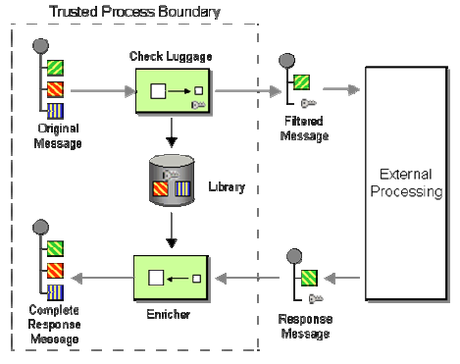
Claim Check (cont.)
We can use the Claim Check pattern to hide sensitive information.
Messages containing an invalid (or expired or already used) key will be blocked by the Content Enricher attempting to retrieve message data using the key.

Slide 27
Integration Basics
Application coupling: it's best to have less dependencies.
Simplicity: when integrating we need to minimize the changes in the applications.
Data format: applications must agree on the format of the data they exchange or must have mediators.
Data timeliness: Data should be exchanged frequently in small chunks, rather than waiting to exchange a large set of unrelated items. Latency in data sharing has to be factored into the integration design.

Slide 28
Conclussion
Patterns offers a reusable solution for a particular problem.

Slide 29

Bibliography
Addison Wesley – Enterprise Integration Patterns

Slide 30
Questions ?

